Slide 1
DEVOPS
Demo by
Vetri selvan k
9791249980,9082782215

Slide 2
Devops-Demo:Agenda
Brief introduction on Devops
Why Devops is Needed rather than wanted
CICD-A key Element in Devops
Tools majorly used in Devops
Overview of course
Agenda of main course

Slide 3
Brief Introduction to Devops
DevOps-Development+Operations
DevOps is a methodology that automates the processes between all IT team functions i.e., Requirement Team, software development, testing team ,Configuration Management team, Database team, Deployment team and Monitoring team.
DevOps is a single unit/person who/which is sole responsibility of a software from development till deployment.

Slide 4
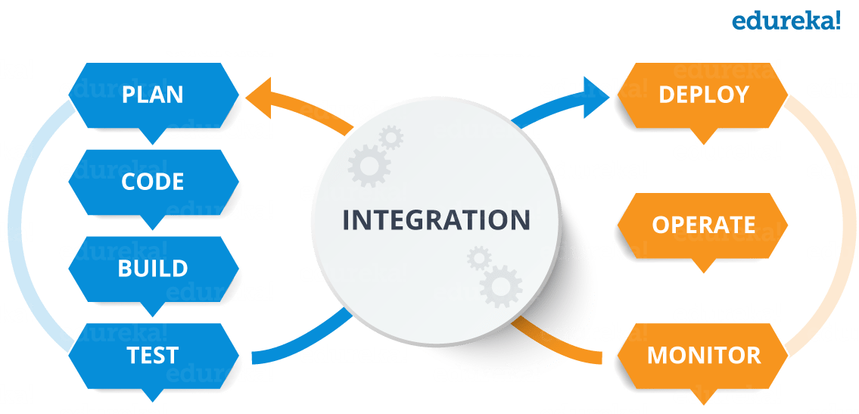
CICD-A key Element in Devops

Slide 5
CICD-A key Element in Devops (Continuous Integration and Continuous Delivery)
CI-CD-Continuous Integration and Continues delivery
Continuous Integration
Developers code integrated to one base line to avoid Integration issues
Automated Build trigger post every commit
Automated testing the build and publishing the test results.
As a result a test-driven-development is achieved
Continuous Delivery
Software is taken to higher environments with manual checkpoints

Slide 6
Why Devops is Needed
Immediate test results post each and every check-in for a test-driven development and Avoids manual human error
Increases an organization's speed to deliver applications and services. It allows organizations to serve their customers better and compete more strongly in the market.
ensuring that the software can be reliably released at any time and, when releasing the software, doing so manually. It aims at building, testing, and releasing software with greater speed and frequency.

Slide 7
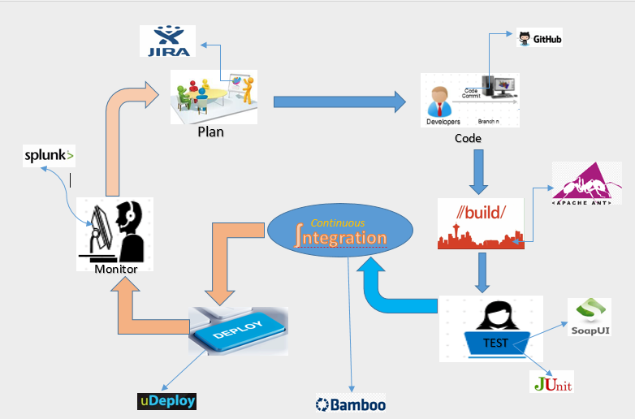
Tools majorly used in Devops

Slide 8
Tools majorly used in Devops
SI No. | SCM-Version Control | Containerization | Configuration Management | Continuous Integration | CLOUD
1 | GIT HUB | Docker Hub | Ansible | Jenkins | AWS
2 | Subversion(SVN) | Kubernetes | Chef | TeamCity | Azure
3 | Team Foundation Server (TFS) | Solaris Containers | Puppet | Bamboo | Google Cloud Platform
4 | Gerrit |  | SaltStack | CircleCI

Slide 9
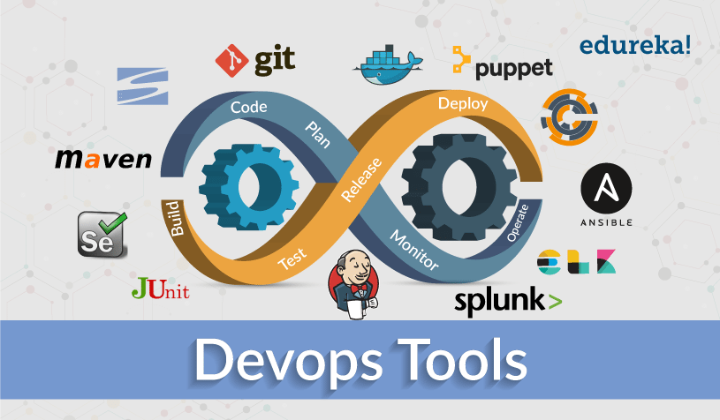
Overview of course

Slide 10
Agenda for Main course
Introduction to DevOps
GIT – A version control tool
Jenkins – Continuous integration
Docker – A containerization technology
Ansible – A configuration Management
AWS-DevOps on Cloud

Slide 11

Your Future Success may start here
All The Best!

